Slide 1
Event-Driven Architecture
Lecturer: Ngo Huy Bien
Software Engineering Department
Faculty of Information Technology
VNUHCM - University of Science
Ho Chi Minh City, Vietnam
nhbien@fit.hcmus.edu.vn

Slide 2
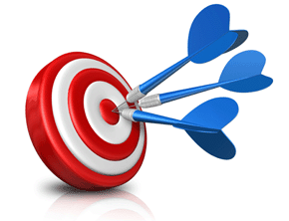
Objectives

Slide 3

Contents

Slide 4

References
Brenda M. Michelson (2006). Event-Driven Architecture Overview.

Slide 5
Problems
A service may crash while processing a request.
Fine grain scalability.

Slide 6
Concepts
Events
Producers
Consumers

Slide 7
Events [1]
An event is a notable thing that happens inside or outside your business. An event (business or system) may signify a problem or impending problem, an opportunity, a threshold, or a deviation.
Each event occurrence has an event header and event body.
The event header contains elements describing the event occurrence, such as the event specification ID, event type, event name, event timestamp, event occurrence number, and event creator. These elements are consistent, across event specifications.
The event body must be fully described so any interested party can use the information without having to go back to the source system.

Slide 8
Event-driven Architecture
In an event-driven architecture, a notable thing happens inside or outside your business, which disseminates immediately to all interested parties (human or automated).
The interested parties evaluate the event, and optionally take action.
The event-driven action may include the invocation of a service, the triggering of a business process, and/or further information publication/syndication.

Slide 9
Extreme Loose Coupling
By its nature, an event-driven architecture is extremely loosely coupled, and highly distributed.
The creator (source) of the event only knows the event transpired.
The creator has no knowledge of the event’s subsequent processing, or the interested parties.
Thus, event-driven architectures are best used for asynchronous flows of work and information.

Slide 10
Event Processing Styles
Type | Situation | System Reaction | Why It Fits
Simple Event Processing | A user clicks the "Submit" button on a form | The system saves the form data and shows a success message | Reacts to a single, isolated event
Stream Event Processing | A temperature sensor sends data every second, rising steadily over 10 minutes | The system sends an alert when the average temperature > 50°C | Monitors a flow of events over time
Complex Event Processing | A user logs in from a new device, disables 2FA, and makes a large transaction in 5 minutes | The system blocks the transaction and notifies security | Detects a suspicious sequence of events

Slide 11
Examples by Domain
Domain | Simple | Stream | Complex
Home Automation | Door opens → turn on hallway light | Monitor room temperature → adjust fan speed every 10 seconds | Motion detected + glass break sound + door opens → trigger alarm
Finance | Card swipe → process payment | Track trades per second → detect abnormal trading spikes | Login + password change + foreign IP transaction → trigger fraud alert
Web Analytics | Page visit → increase page view count | Track visit rate → notify if traffic drops 50% within 5 minutes | Series of bounces from ad campaigns → alert marketing
Healthcare | Button press on nurse call → alert nurse | Monitor heart rate stream → alert if pulse > 120 bpm for 2 minutes | Patient reports chest pain + ECG abnormal + low oxygen → trigger emergency

Slide 12
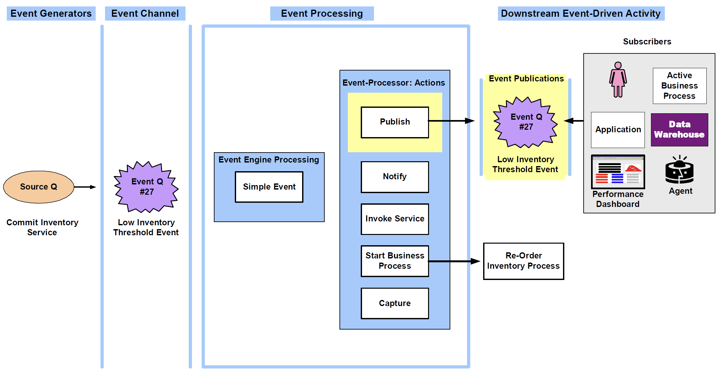
Simple Event Processing Flow

Slide 13
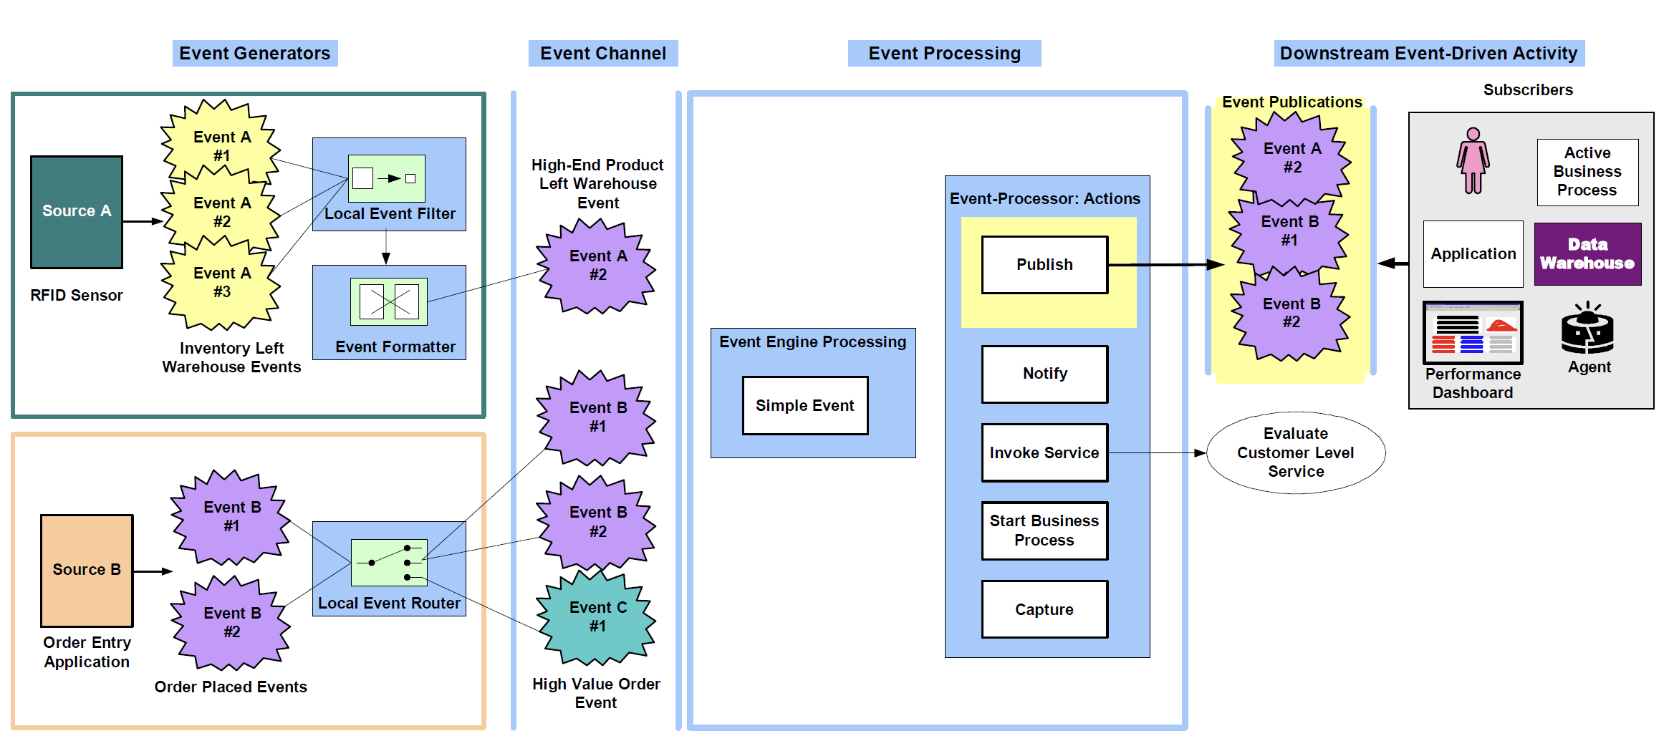
Stream Event Processing Flow

Slide 14
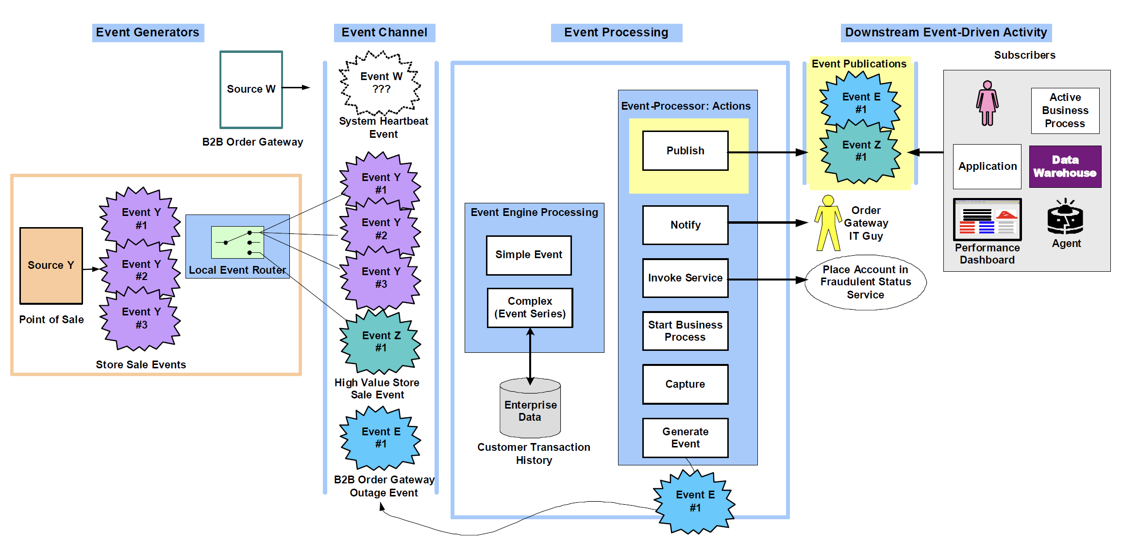
Complex Event Processing Flow

Slide 15
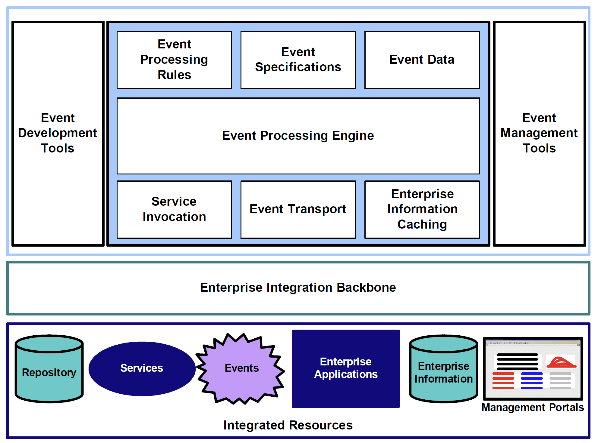
EDA Implementation Components

Slide 16


Slide 17
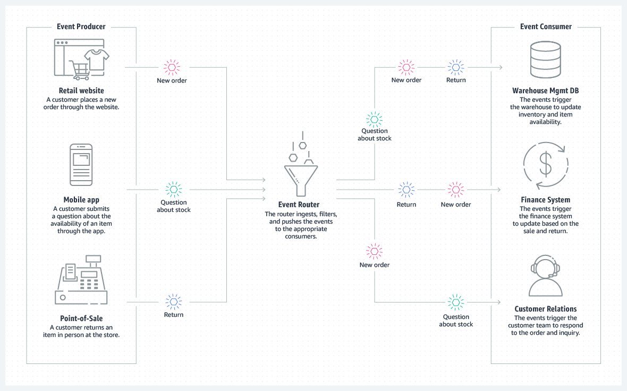
Architecture

Slide 18
Point-to-Point Communication
One producer → Event bus → One consumer.
Example event bus: Amazon SQS.
Why don't producer just call consumer? - Leveraging distributed reliable replicated storage.

Slide 19
Pub-Sub Communication
Producers → Event bus → Consumers.
Example event bus: Amazon SNS, Amazon EventBridge.
Why don't producer just call consumer? - Leveraging distributed reliable replicated storage.

Slide 20
Integration
Producers → Pipes → Consumers.
Example pipes: Amazon EventBridge Pipes.
Why pipes? - No code integration.

Slide 22
"Event-Driven" Meaning
https://martinfowler.com/articles/201701-event-driven.html
Event Notification: This happens when a system sends event messages to notify other systems of a change in its domain.
→ Communication.
Event-Carried State Transfer: This pattern shows up when you want to update clients of a system in such a way that they don't need to contact the source system in order to do further work.
→ Workflow, process.
Event-Sourcing: The core idea of event sourcing is that whenever we make a change to the state of a system, we record that state change as an event, and we can confidently rebuild the system state by reprocessing the events at any time in the future.
→ Storage.

Slide 23
When is Request Complete?
Let's say there's a service called "CreateOrder". Let's say as well that the service depends on "Inventory" service to check whether the items in the order are available, and also "Location" service that determines whether the shipping destination is within the supported area.
In the classical approach it is easy. The client just call the "CreateOrder" service, then CreateOrder will call Inventory and Location services (either sequentially or parallel). Only then when both services returns "OK" that CreateOrder return successfully to the client with an OrderId, for example.
How about the event driven approach?
The client calls the CreateOrder service.
Create order post the request into a message broker (let's say kafka) into a pre-defined topic (let's say "Inventory" and "Location" topics).
The Inventory and Location service consume the event from the message broker and process the request.
How the CreateOrder service get the result so it can get back to the client?

Slide 24
Solution
The Inventory and Location service can push an event to kafka again upon completion, which the CreateOrder service can subscribe to.
The client should be able to be the one to decide whether it needs to and how often to check the order status.
If that query load is problematic, CQRS again comes in handy: you can generally scale the read model (the portion of the system needed for queries) to an arbitrary degree and take advantage of things like in-memory caching and pre-computing expensive frequent queries.
The system may use bidirectional protocols like websockets and gRPC not unidirectional message queues.

Slide 25
https://www.cloudamqp.com/

Slide 26

Thank You & See You Again

